Slide 1
Bombastic Bookstore
Team Members: Brandon Biggs, Joshua Macy, Julia McDonald, Ryan Burres, James Dove, and Jaylan Chavis
Date: December 9th, 2024
Notes:
Project Manager: Brandon

Slide 2

Introduction
Local Server built on Django and SQL for Managing Books
Purpose: Create an inventory management system for bookstore owners
Importance: Because books are awesome!
Notes:
Brandon Presents!!

Slide 3
Overview
At a high level, this is a local server for storing book information.
Target Audience
Bookstore Owners
Bookworms
Scope and features
Database Manipulation
Theme Customization
Notes:
Brandon Introduces.

Slide 4


Development Process
Agile Methodology
- Sprint 1 Setting Up the Backend
- Sprint 2 Barebones Front End
- Sprint 3 Finishing the Backend
- Sprint 4 Finishing Front End
- Sprint 5 Overall Polish
Bombastic Bookstore Product Deliverable!
Notes:
Brandon prepares for Joshua’s slide…

Slide 5


Sprint 1
Set up development environment
Github Repository
Trello
Django
SQL Database set-up
Testing with browser output
Notes:
Joshua Macy’s Slide

Slide 6
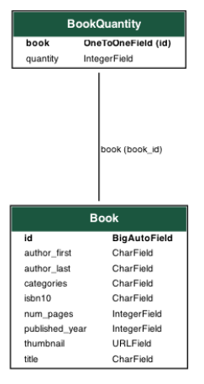
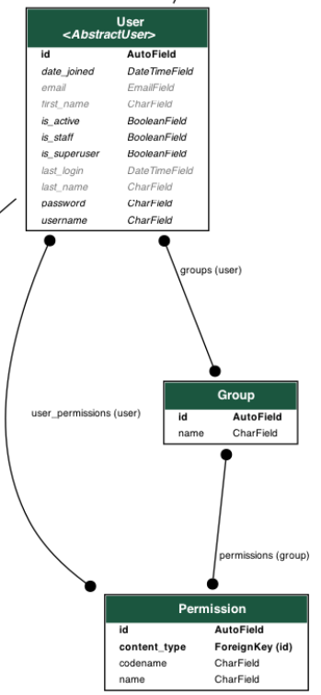
Notes:
Joshua Continued

Slide 7

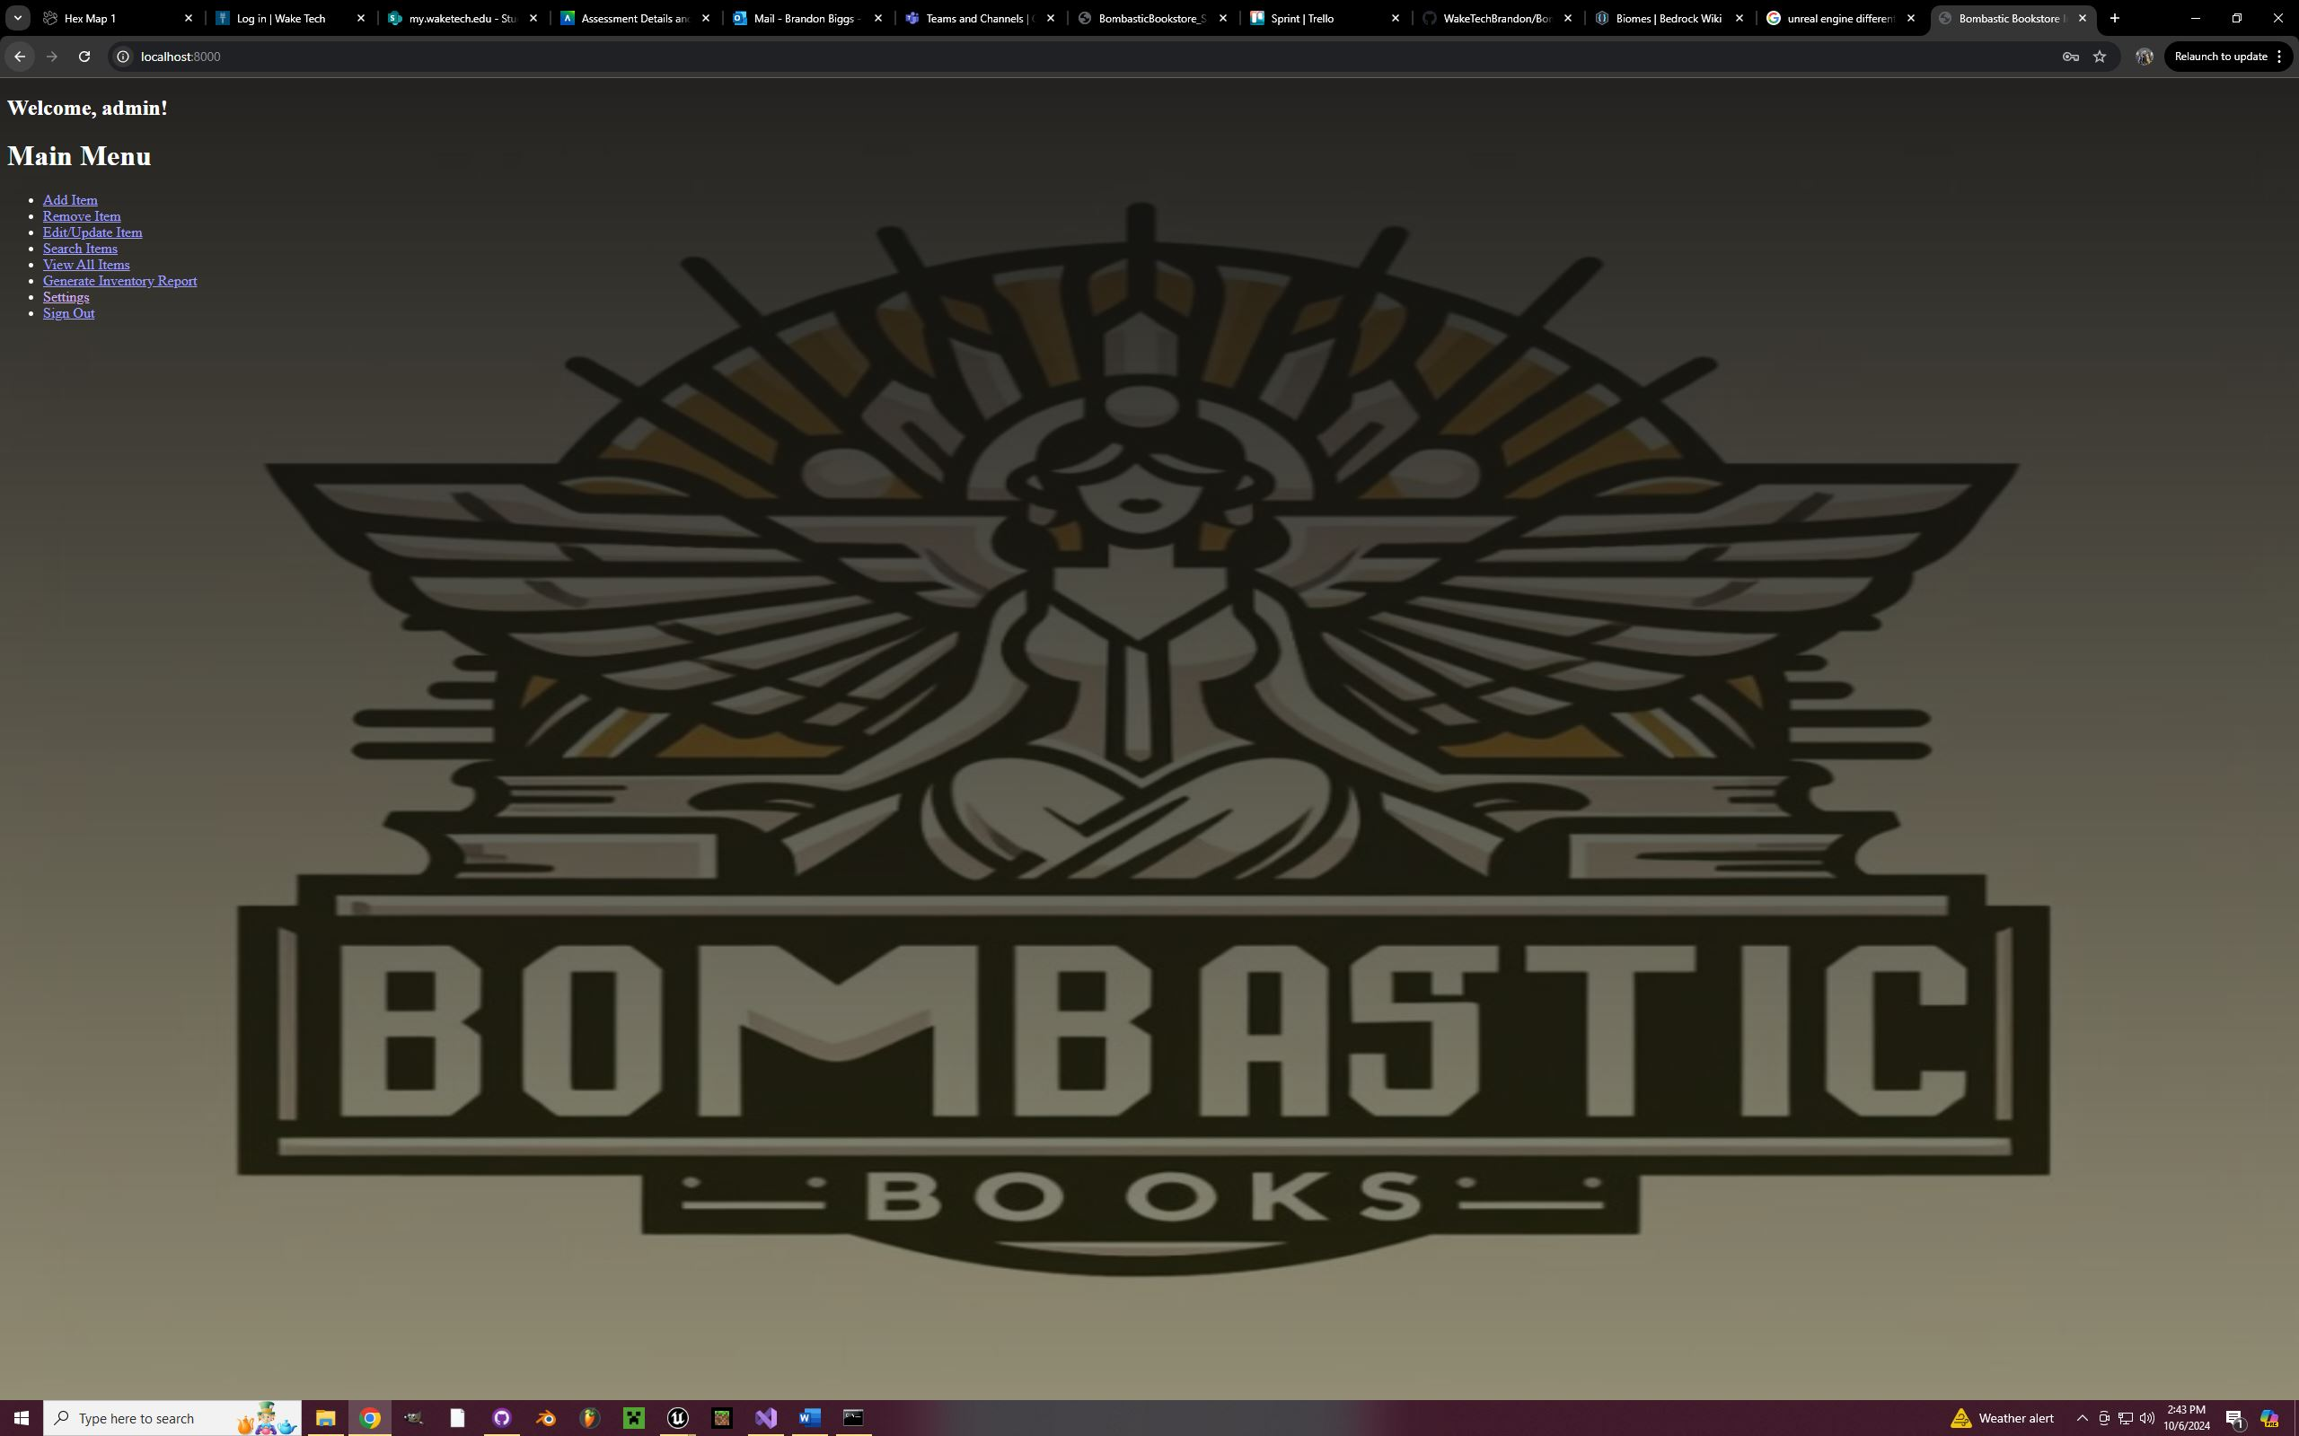
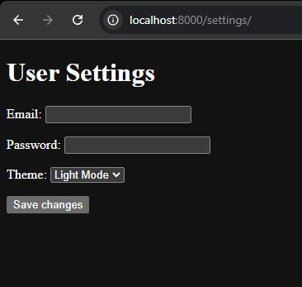

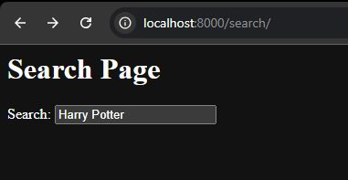
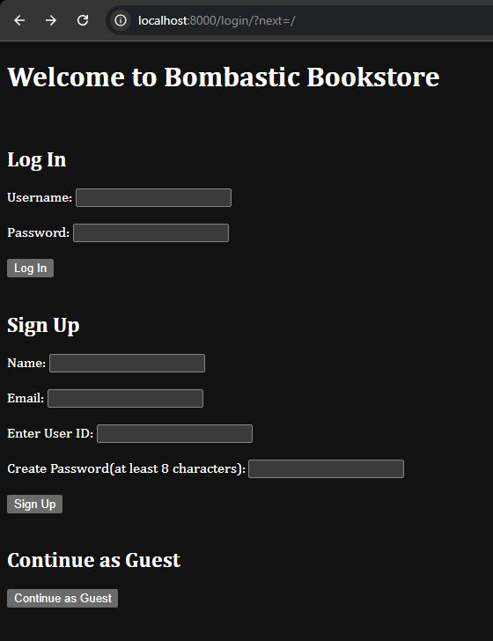
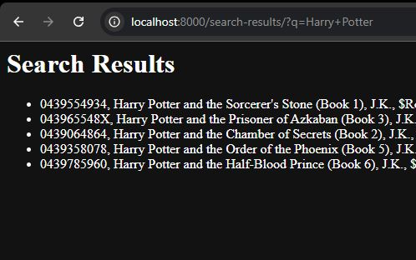
Sprint 2
Barebone websites
Inventory Menu
User Settings Menu
Search Menu
Login Menu
Notes:
Julia McDonald’s Slide

Slide 8
Sprint 3
Complete Features for backend:
Adding items to database
Removing items from database
Editing/Updating database items
Search Item
Implemented User Access Control
Notes:
Ryan Burres’s Slide

Slide 9
Sprint 4
Finish Frontend Functionality
CSS Templates
View All Page
Search Results Page
Restructured Webpages
Interconnection
Notes:
James Dove’s Slide

Slide 10
Sprint 5
Overall Polish
Webpage cohesion
Background, and login page images created
Notes:
Jaylan Chavis’s Slide

Slide 11
Challenges:
Struggled to relearn Django and Python
Scheduling Conflicts
Work vs Meetings
Local Hurricane
Sign-up Page and Login Page needed split
Notes:
Brandon Biggs’s Slide

Slide 12
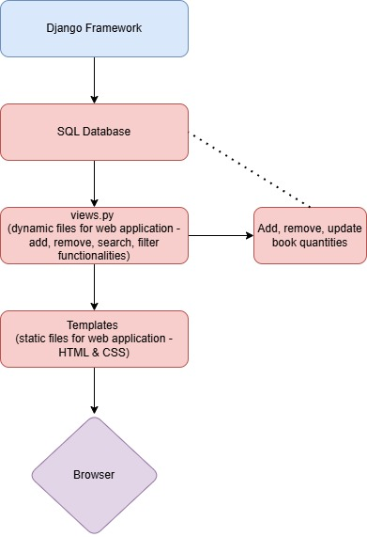
Architecture and Design
Overview of software architecture
Design principles and decisions

Slide 13
Key Features
Inventory Management
Adding, removing, editing, etc
Organization, Customization, Controlled User Access Levels
Screenshots or demos of key features

Slide 14
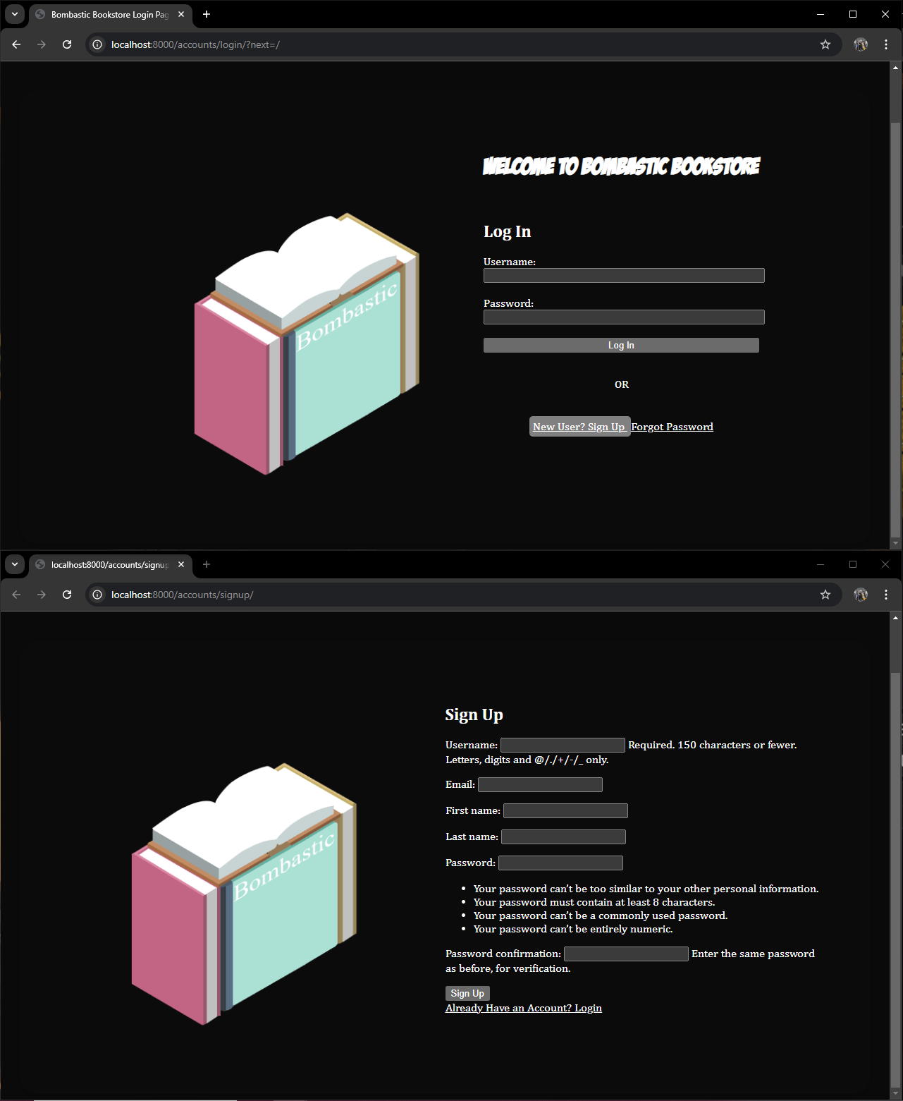
Login and Sign Up Page
Login and Sign-Up for Multiple User capability

Slide 15
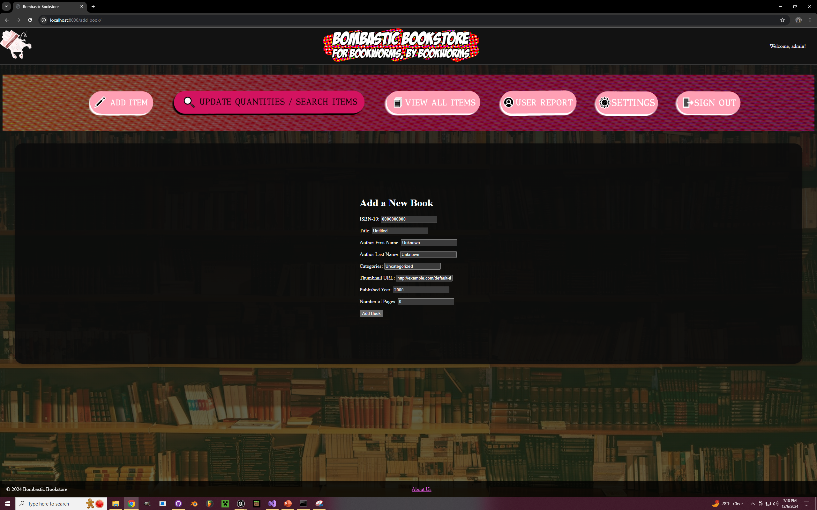
Add Books
Fill out the necessary categories.
The “Add Book” button then submits the information to the database.

Slide 16
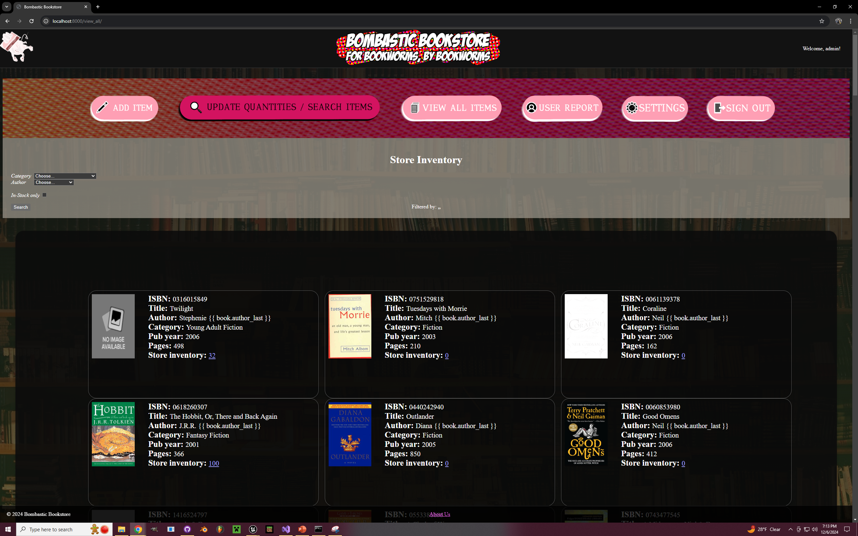
View All Page
Easy Access to full database inventory
Filter Capability

Slide 17
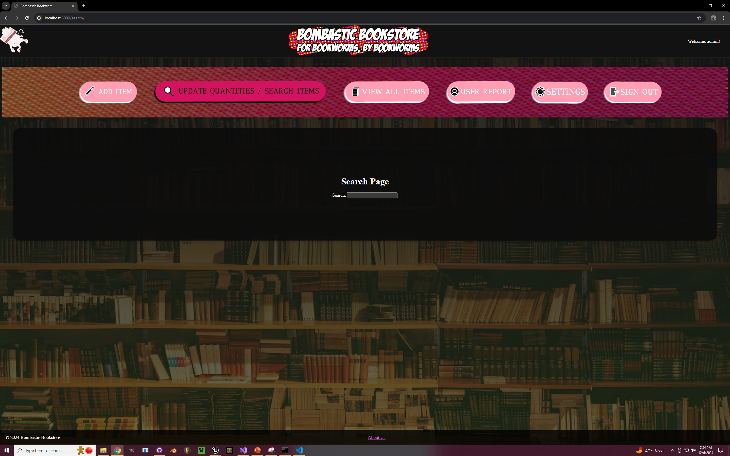
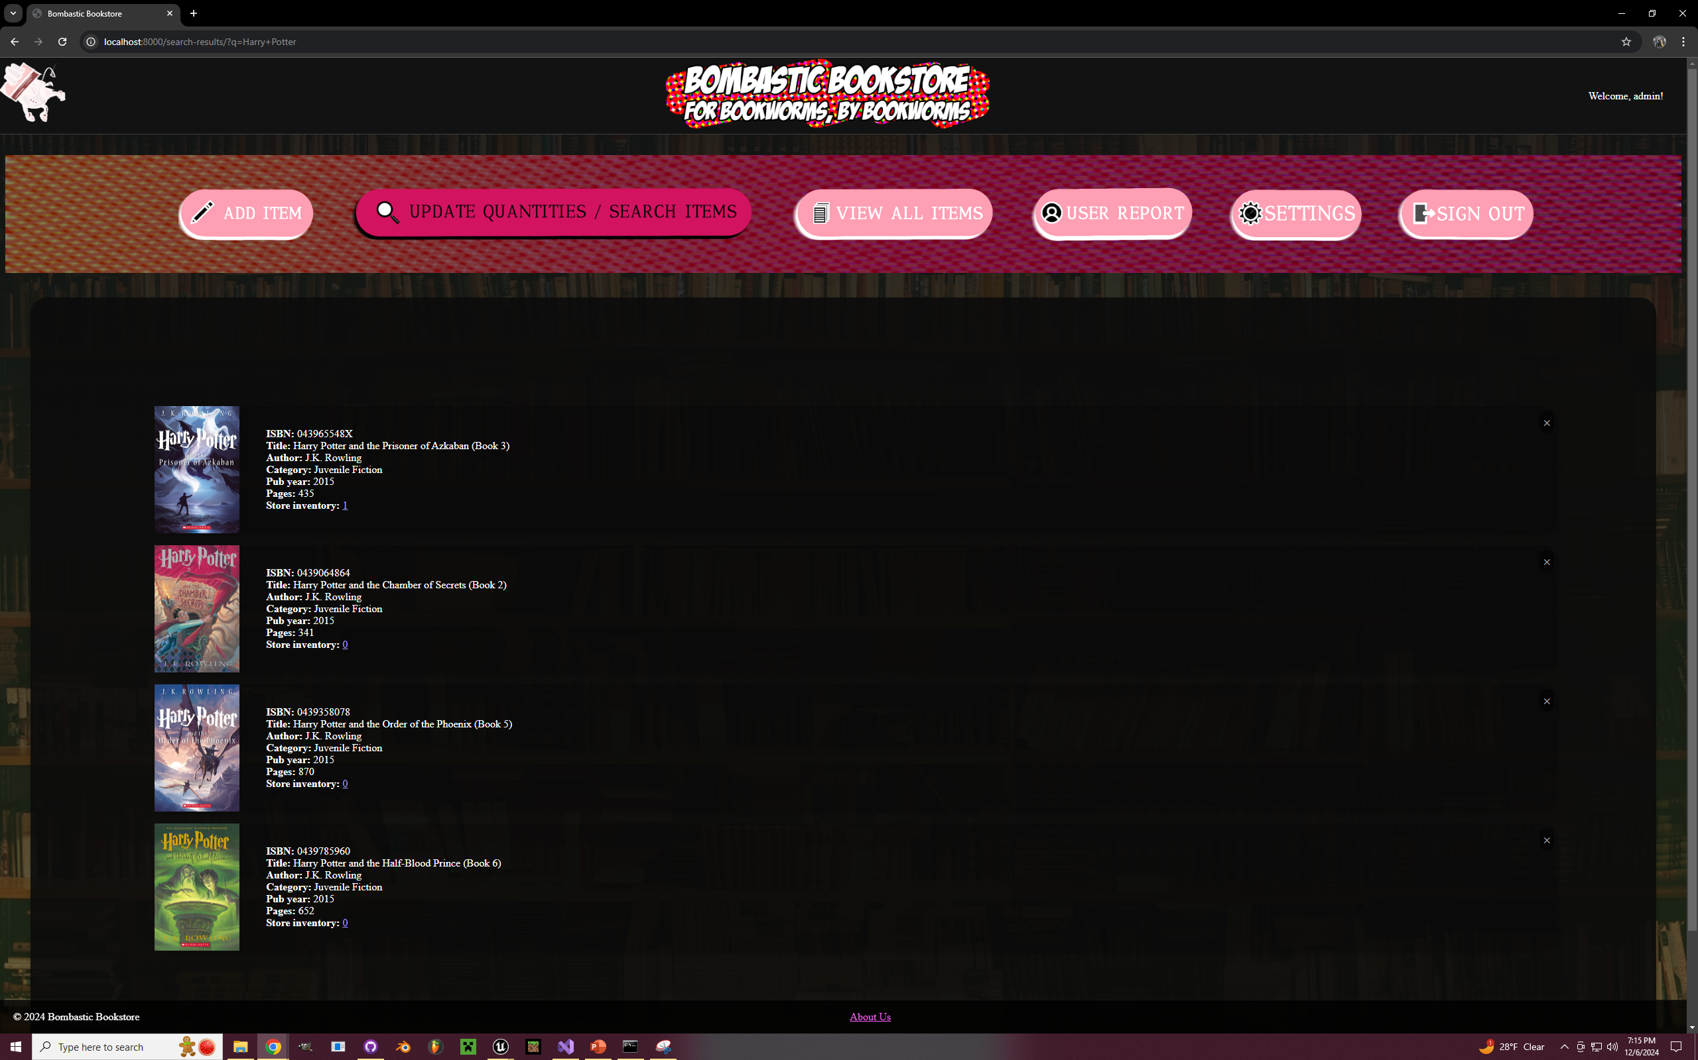
Search Results
Find books quickly
Click the X for Book Removal Confirmation

Slide 18
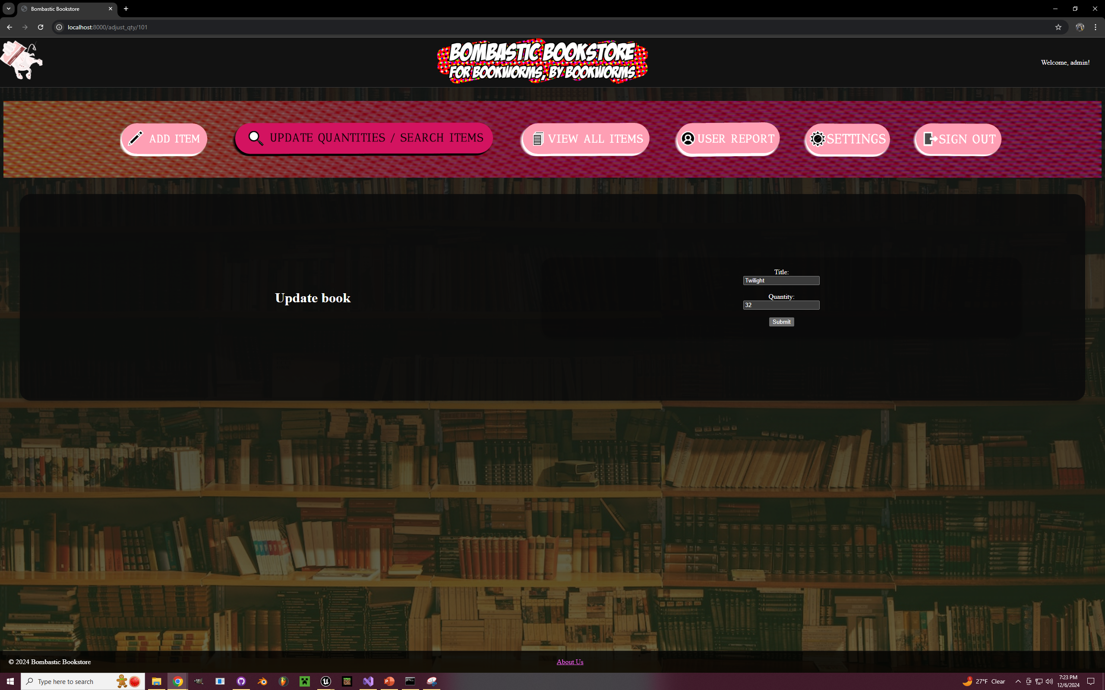
Update Quantity Page
Dedicated Page for updating bookstore quantity per book.
Accessed from either Search Results or View All quantity amount clicked.

Slide 19
Development Highlights
Major Achievements and milestones
Setting up a server-deployed application
Manipulating a SQL Database
CSS Themes

Slide 20
Testing and Quality Assurance
Manual Testing
Checked Input validation
Visual Bugs
Github Pull Request/Review Process

Slide 21

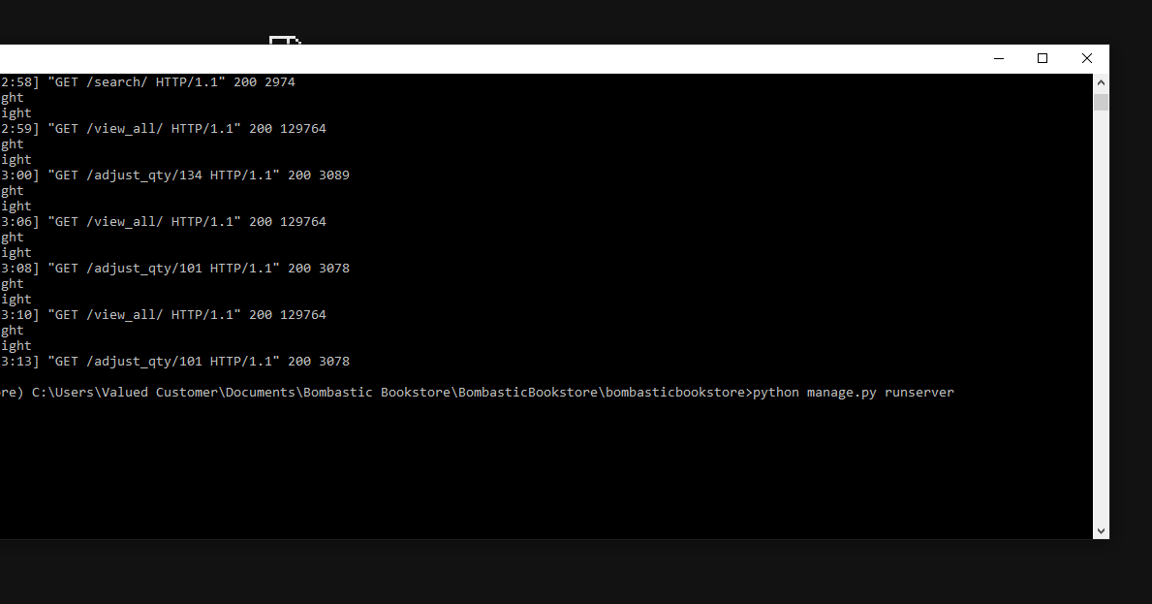

Deployment
Has a built-in installation tool.

Slide 22
User Feedback
The website was ugly.
Login Page did not mesh well with main page.
Improved aesthetics as a result.
Login Page conformed and simplified.

Slide 23
Future Plans
Comic book-like aesthetic
Deployment to Google Cloud
Online Storefront/Shopping feature

Slide 24
Conclusion
Recap of key points covered in presentation
Thank you
Contact information:
Jaylan Chavis: jmchavis3@my.waketech.edu
Ryan Burres: rsburres@my.waketech.edu
Brandon Biggs: bmbiggs@my.waketech.edu
James Dove: jedove@my.waketech.edu
Joshua Macy: jmacy@my.waketech.edu
Julia McDonald: jfmcdonald@my.waketech.edu

Slide 25

Questions
?
This Photo by Unknown Author is licensed under CC BY-NC

